Slide 1


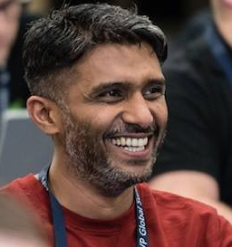




Speaker
Anoop C Nair
Azure Virtual Desktop & Windows 365 Modern Virtualization Solutions with Modern Management
Anoop C Nair
anoopmannur
September 16th & 17th
^{Online Event}
Powered By
International Conference

